Slide 1

Electric water heater
By: Ahmed Ashraf Mohamed

Slide 2



Agenda
Introduction
Components required
Design
Specification

Slide 3


Introduction
water heater is an appliance that uses electricity, instead of gas, to heat the water that will be used throughout a home electric.

Slide 4

Components Required
Atmega-32
Buttons
LEDS
2 Seven Segmant
TemperatureSensor (lm35)
2Motors(DC)
Oscilloscope
EEPROM (M24C16)
Resistance
H-Bridge(L293D)
BCD to 7-Segm(4511)

Slide 5
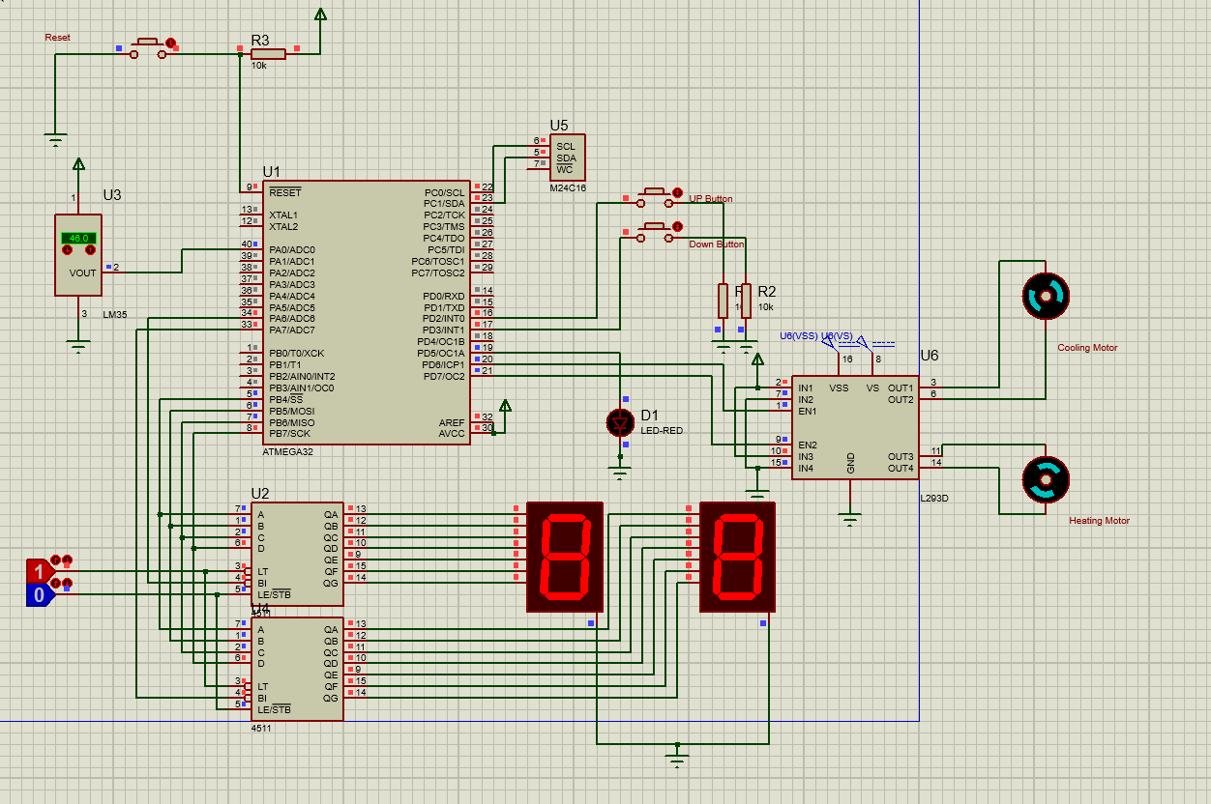
Schematic Design using proteus

Slide 6
Specifications
Temperature setting
Temperature Controller

Slide 7
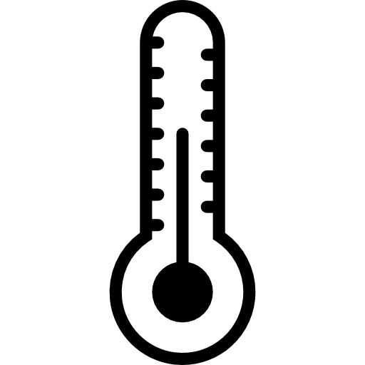
Temperature Setting

Slide 8
The “Up” or “Down” buttons are used to change the required water temperature (set temperature).
The first “Up” or “Down” button press, enters the temperature setting mode.
After entering temperature setting mode, a single “Up” button press increase the set temperature by 5 degrees.
After entering temperature setting mode, a single “Down” button press decrease the set temperature by 5 degrees.
The minimum possible set temperature is 35 degree, and the maximum possible set temperature is 75 degree.
If the electric water heater is turned OFF then ON, the stored set temperature should be retrieved from the “External E2PROM”.
The initial set temperature is 60 degrees for opening in the first time.
If the electric water heater is in the temperature setting mode, the 2 seven segment displays should blink every 1 second and show the set temperature.
In the temperature setting mode, every change in the set temperature should be reflected on the 2 seven segment displays.
The 2 seven segment display should exit the temperature setting mode, if the “UP” and “Down” buttons are not pressed for 5 seconds.

Slide 9
Temperature Control

Slide 10
The temperature sensor measures the water temperature.
The water temperature should increase, if the “Heating Element” is ON.
The water temperature should decrease, if the “Cooling Element” is ON.
The “Heating Element” should be turned ON, if the current water temperature is less than the set temperature by 5 degrees and vise versa.
The “Cooling Element” should be turned OFF, if the current water temperature is less than the set temperature by 5 degrees and vise versa.
Seven segment by default show the current water temperature or the set temperature.
If the “Heating Element” is ON, the “Heating Element Led” should blink every 1 second. 2. If the “Cooling Element” is OB, the “Heating Element Led” should be ON.

Slide 11

Summary
water heaters are much more efficient than gas heaters and safer.
With variety of much than one type it can be the best choice for users.

Slide 12
Thank You

